Slide 1
HEALTH CARE APPOINTMENT BOOKING WEBSITE
Submitted by:
Bibek Poudel [BEC-2019-04]
Kushal Duwadi [BEC-2019-11]
Kritika Shrestha [BEC-2019-10]
Smriti Kafle [BEC-2019-24]
Paras Poudel [BEC-2019-13]

Slide 2

INDRODUCTION
Healthcare booking system is a web based computerized system that provides a platform for hospitals, clinics and other health services providing organizations to manage hospital facilities through online medium. It is mainly focused to provide the best facilities to each and every patients. This web based design will make easier to subscribe the package and further expansion on package will be possible with less effort. Hospitals and Clinics have the access to control the official package/offers or to add/delete/update information the doctors or the facilities available.

Slide 3
STATEMENT OF PROBLEM
01
Time consuming for reservation and appointment
02
Data duplication and Over Reservation
03
Limited reach for facilities to normal patients
04

Slide 4
OBJECTIVES
1
To provide emergency information in critical situations.
To optimize the available resources and to make reminders/cancellations/reschedules easily and also delivers a premium experiences.
2
3
To improve the quality of patients care and patients satisfactions.
To provide online consultant service with the best experts.
4

Slide 5
APPLICATIONS
Cabin and Appointment Availability.
Reservation
Patients database management
Search all previous patients data

Slide 6
LITERATURE REVIEW
Hamro doctor
It is an online consulting website which provides patients to have virtual routine consultation with the top doctors .It also provides few of the physical appointments and it is based on Kathmandu area only.
Clinic one
It is also a well managed online consulting website but with limited features and limited health consultant. It is completely online based.
Doctors on call
It provides many features like home facility of doctor visit, at home, nursing care at home, laboratory test at home and so on.
Mero doctor
It has most advanced feature web based system providing data and names of different doctors working on various shift on multiple hospitals making the appointment service easy to book.

Slide 7
WATERFALL
MODEL
DIAGRAM
METHODOLOGY
Figure : WATERFALL MODEL

Slide 8
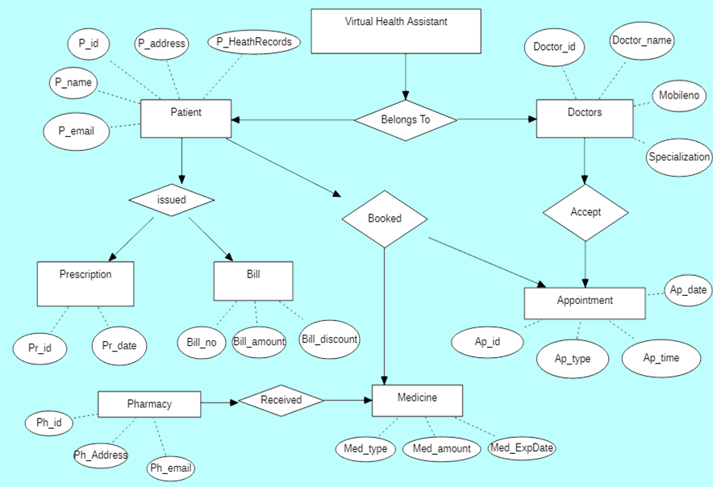
ER
DIAGRAM
Figure : ER Diagram

Slide 9
EXPECTED OUTCOME
Since, our project is platform for health service provides and the health service receiver(patients) we have consult with many health service providers and many health workers from their review we have expected to be top most online site providing facilities to the consumers. We will be shorting the distance between the lengthy paperwork or queue problems for booking and appointment. This platform is developed to reduce the health problem caused due to the unmanaged old paper based system with a minimal error.

Slide 10
GANTT
CHART
Figure: GANTT CHART

Slide 11




SOFTWARE DEVELOPMENT

Slide 12
REFERENCES
1.Hamro Doctor https://www.hamrodoctor.com/
2.Clinics One https://www.clinicone.com.np/online-consultation-in-nepal/
3.Doctors on Call https://doctorsoncall.com.np/appointment/
4.Mero Doctor "https://www.merodoctor.com/doctors/finddoctors?dep=true

Slide 13
THANK YOU

